Slide 1
Nurse Licensing Examination Process
Washington State Board of Nursing (WABON)
Notes:
GREEN WA PRESENTATION TITLE SLIDE
Quick Help Tips
Presentation Title Box:
just add text
Washington State Department of Health Box:
just add program/office name or use as is
If titles/text are lengthy, boxes can be adjusted by dragging/stretching them for best visual appeal

Slide 2
Nurse Licensure Compact
Washington state joined the Nurse Licensure Compact (NLC) on July 24, 2023. The NLC increases access to nursing care while maintaining public protection at the state level.
RNs or LPNs with an active multistate license (MSL) can practice in Washington state and other NLC states and territories, without getting additional licenses.
Washington State is issuing MSLs effective January 31, 2024.
An MSL is issued in a nurse’s primary state of residence (PSOR) and is recognized across state lines (like a driver’s license) in participating NLC states.

Slide 3
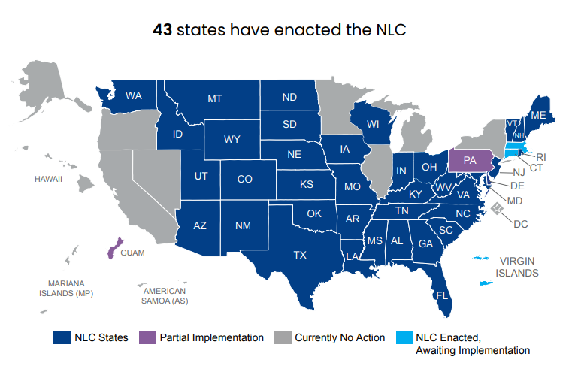

Slide 4
Benefits of a Multistate License
Access to Care: Expands access to nursing services across the country, including underserved communities.
Telehealth: Provide telehealth services without having to get additional licenses.
Disaster & Pandemic Relief: Immediately cross state borders to provide vital services.
Military Families: Military spouses seamlessly continue working without having to get a new license.
Online Education: Reduces educators’ need for multiple licenses.
Cost Effective: Makes practicing across state borders affordable and convenient.
Flexibility: Choose a single or multistate license based on interests and eligibility.

Slide 5
Single State vs Multistate License
Washington Single State License | Washington Multistate License (MSL)
Allows practice in Washington State only. | Allows practice in Washington State and 40 other participating compact states.
Initial License Fee: $138 for RN, $93 for LPN | Initial License Fee: $203 for RN, $158 for LPN
Annual Renewal Fee: $138 for RN, $93 for LPN | Annual Renewal Fee: $158 for RN, $113 for LPN
Initial License by Exam Requirements: Application, fee, complete a BON approved program, official transcripts, pass NCLEX, and FBI fingerprint background check (if out of state address). | Initial License by Exam Requirements: Application, fee, complete a BON approved program, official transcripts, pass NCLEX, FBI fingerprint background check, Valid SSN, and WA State PSOR. Note: Must not be a participant in an alternative to discipline program or have ever been convicted of a felony.

Slide 6
Step 1: Submit Your Application
Follow online application instructions at: https://nursing.wa.gov/licensing/apply-license
Create a Secure Access Washington Account at: https://secureaccess.wa.gov/myAccess/saw/select.do
If you will be ready to take the NCLEX immediately after completing your nursing education program, please submit your online application 2-3 weeks prior to your completion date.
If you plan on waiting to take the NCLEX, please do not apply until 2-3 weeks prior to when you will be ready to test to avoid closure of an incomplete application.
To check the status of your application, please use the Provider Credential Search
Notes:
TITLE & CONTENT
Quick Help Tips
Text Box:
just add text
More text boxes can be added if needed

Slide 7
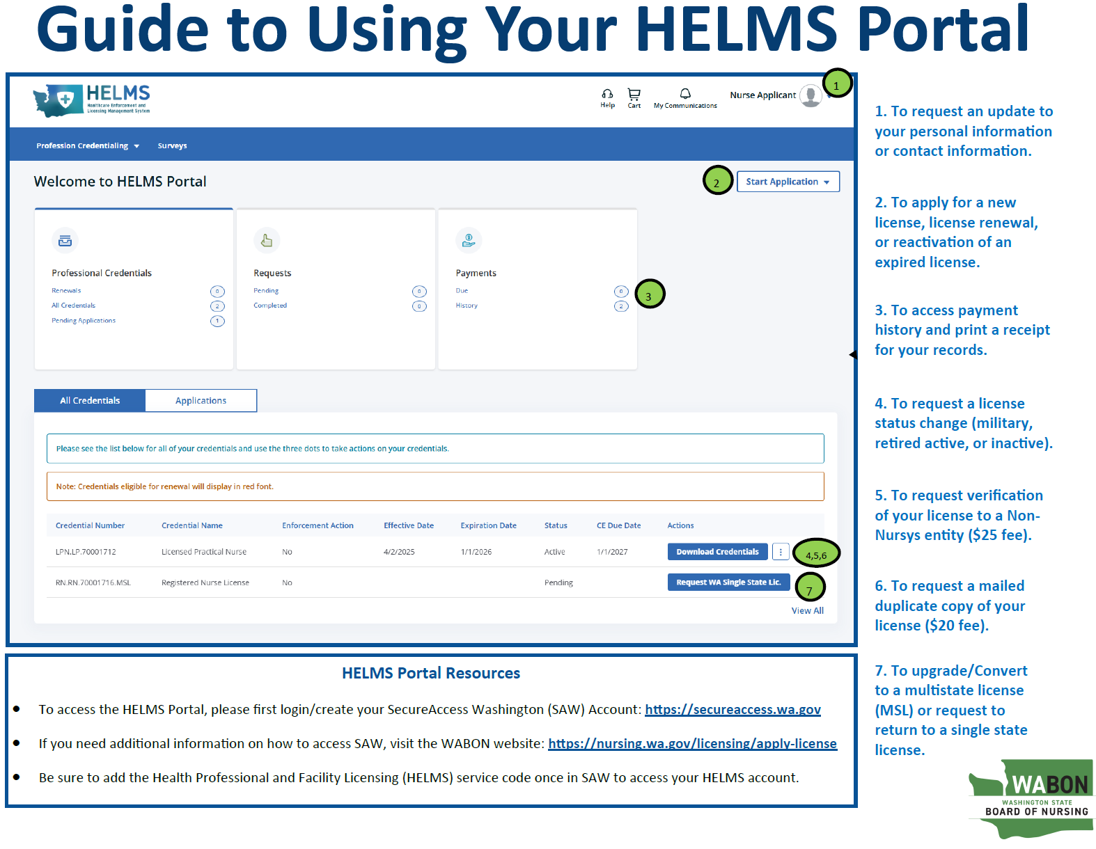
HELMS Portal
(Go-Live Date: April 29, 2025)

Slide 8
Helpful Hints
Please always keep your contact information current with the WA BON.
Make sure to use your personal email address when creating your Secure Access Washington (SAW) account and write down your login information somewhere safe. SAW is used for licensure renewal after you are licensed.
Your initial application will show a “pending” status with the on the Provider Credential Search as soon as your application is submitted online.
Notes:
TITLE & CONTENT
Quick Help Tips
Text Box:
just add text
More text boxes can be added if needed

Slide 9
Note: To simplify your search, only enter your first and last name.
Notes:
IPAD FOR LARGE SCREENSHOTS
Quick Help Tips
Photo Box inside iPad Screen:
click on the icon in the middle of the box to insert photo
photo will automatically size to fit the designated area
photo size can also be adjusted

Slide 10
Step 2: Criminal Background Checks
A Washington State Patrol (WSP) background check and National Practitioner Database (NPDB) are conducted on all applicants.
FBI fingerprint background checks are required for all applicants who apply for a multistate license (MSL) or single state applicants who apply with an out-of-state address. You will receive emailed instructions on this process.
Notes:
TITLE & CONTENT
Quick Help Tips
Text Box:
just add text
More text boxes can be added if needed

Slide 11
Step 3: Register for the Exam
Register online to take the NCLEX exam and submit the $200 fee to Pearson VUE before graduation.
Credit or debit card only
You can register up to one year prior to exam
Pearson VUE is contracted by the National Council of State Boards of Nursing (NCSBN)for test development and administration of the NCLEX Examination. www.pearsonvue.com/nclex
Notes:
TITLE & CONTENT
Quick Help Tips
Text Box:
just add text
More text boxes can be added if needed

Slide 12
When registering for the NCLEX examination please be sure…
Your email address is current and correct (use a personal email)
Your school and degree are correctly identified in the appropriate fields when registering (i.e.: BSN, MSN, LPN, RN)
Your personal ID matches your Pearson VUE registration exactly (middle initials are fine)
Notes:
TITLE & CONTENT
Quick Help Tips
Text Box:
just add text
More text boxes can be added if needed

Slide 13
Applicant Legal Name
Please be sure you have worked with your school of nursing to ensure your legal name is on file.
Your school should have your legal name and birth date entered on the certificate of completion to match your application, registration with Pearson Vue, personal ID, and official transcripts.
If you have a legal name change (marriage, divorce, or legal court ordered name change) occur during the application process, please be sure to send in legal name change documentation along with your application.
If you have more than one last legal name, please be sure your school is aware, and your legal name is provided on all documents.

Slide 14
WABON Internal Review Process
Now that the WABON has your application, this is what happens in our office:
We complete the intake of your application (1 day after online submission)
We complete the background checks
We send you an email outlining the FBI fingerprint process, if applicable (out of state addresses only)
We send you an initial email requesting you to:
Register with Pearson Vue (if you have not already)
Submit your official transcripts (upon degree conferral)

Slide 15
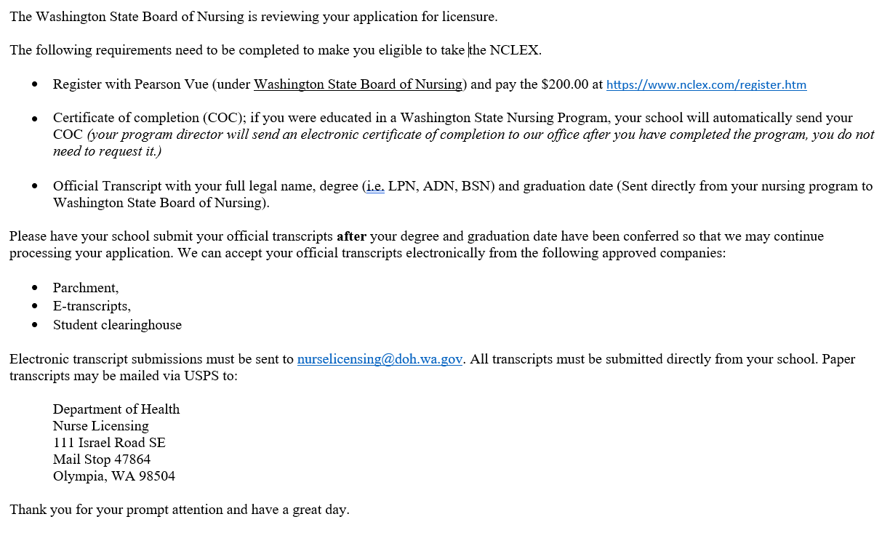
First Email Sent to Exam Applicant (Example Below)

Slide 16
Step 4: Authorization to Test
The certificate of completion (COC) is sent directly from your school of nursing to the WA BON once you have successfully completed your nursing education program.
The WABON will make you eligible to test upon receipt of the COC (if the NCLEX registration is complete).
Pearson VUE sends you the Authorization to Test (ATT) via email within 24 to 48 hours of being made eligible to test.
Notes:
TITLE & CONTENT
Quick Help Tips
Text Box:
just add text
More text boxes can be added if needed

Slide 17
WABON Process After Granting ATT
Now that the WABON has your COC or official transcripts, this is what happens in our office:
We manually make you eligible to test in Pearson Vue
We update your application date to the date you are made eligible to test. This moves the timeline so that you do not receive an automated application closure warning letter until 30 days after this date.
We send you a second email requesting:
Schedule your NCLEX within 30 days of the ATT
Submit official transcripts (if not already submitted)

Slide 18
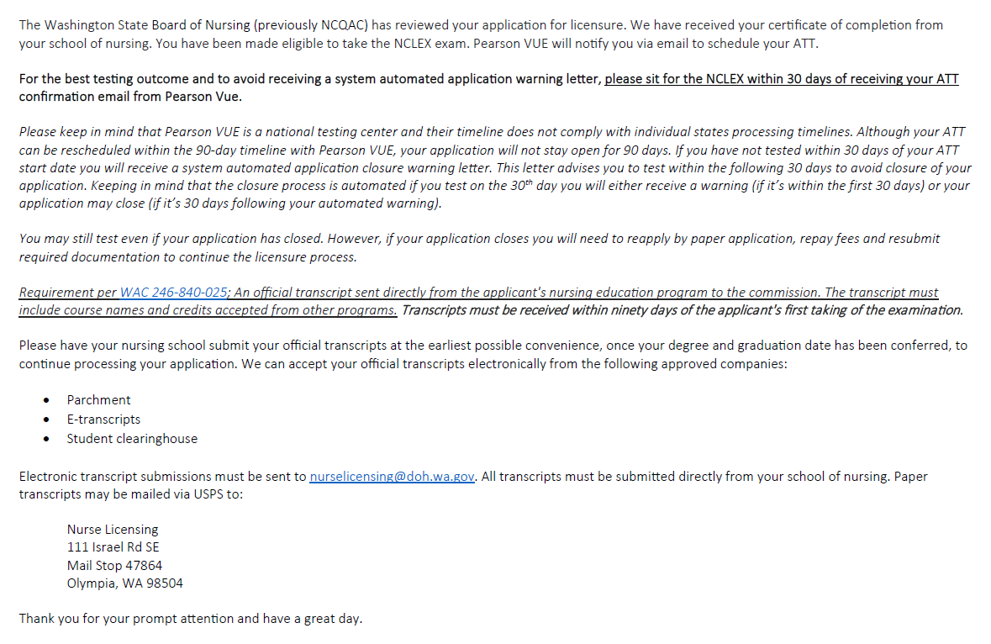
Second Email Sent to Exam Applicant (Example Below)

Slide 19
Flow Chart of Examination Process
Application Received by WABON
Intake Review Completed by WABON
Background Checks Completed Internally by WABON
Exam Desk Initial Review and First Email Sent to Applicant
COC or Official Transcripts Received
WABON Grants Testing Eligibility in Pearson Vue
Pearson Vue sends ATT via Email to Applicant
Applicant Schedules the NCLEX
Applicant Sits for the NCLEX
WABON Pulls Pass/Fail Scores from Pearson Vue
Pass- Complete Application Sent to Final Approval
Application Reviewed and License Issued
Note: Each time we send a request for additional information to an applicant, the start date for the automated application warning starts over (Allowing an additional 30 days before an additional automated application closure warning letter is sent). Each reset is marked by a . After an applicant receives an automated closure warning, they still have 30 days to complete the requirement before the file is closed as incomplete due to inactivity.
Applicant Sits for the NCLEX (Must wait 45 days from initial NCLEX date)
Fail- Applicant is Sent Results and Instructions to Re-register/Schedule
Key
Green = Applicant or school
Blue = WABON or Pearson Vue

Slide 20
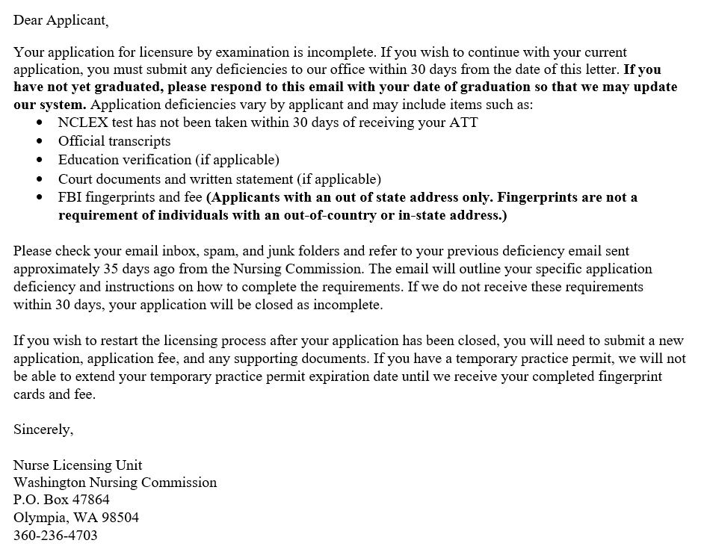
Automated Application Closure Warning Letter (Example)

Slide 21
Testing Accommodations
NCLEX testing accommodations must be ADA approved and the following must be submitted with the application. The WA BON submits your request to NCSBN for a decision.
Applicant letter requesting accommodation and why.
Letter from the school stating what accommodations were provided and why.
A letter from the physician or advanced registered nurse practitioner who made the diagnoses, what the diagnosis is, and what is recommended.
Notes:
TITLE & CONTENT
Quick Help Tips
Text Box:
just add text
More text boxes can be added if needed

Slide 22
Testing Availability
The test date availability varies depending on the time of year
First-time test takers are guaranteed testing dates within 30 days (please call us if you are not seeing availability)
Repeat candidates are allowed to test every 45 days
You may decline and schedule further out, but this is not recommended
If you need to cancel or reschedule your NCLEX, please reference NCSBN’s Rescheduling Policy.
Notes:
TITLE & CONTENT
Quick Help Tips
Text Box:
just add text
More text boxes can be added if needed

Slide 23
NCSBN Studies Related to NCLEX
NCSBN has conducted several studies exploring the relationship between a time delay in taking the NCLEX and the likelihood of successfully passing the exam. A study conducted by Woo noted that a candidate’s delay in taking the NCLEX is inversely associated with the candidate’s pass rate; in other words, as the candidate’s delay increases, the likelihood of passing the NCLEX decreases (Woo et al., 2009).
Similarly, a study completed by Kaminski-Ozturk reflected a downward trend in the likelihood of passing the NCLEX as the number of days in the delay increased. Notably, RNs who postponed their exam for more than 60 days and PNs postponing more than 90 days are more likely to retake the exam due to an unsuccessful initial attempt (Kaminski-Ozturk et al., 2022).
Additionally, the data reflected that RNs and PNs who delay for more than 360 days passed the NCLEX at 62% and 78%, respectively (Kaminski-Ozturk et al., 2022).
Kaminski-Ozturk, N., Smiley, R., Zhong, E., & Martin, B. (2022). A Retrospective Review of NCLEX Candidates’ Testing Behavior: Examining the Relationship Between Repeat Testing, Time-to-Test, and Discipline. Journal of Nursing Regulation, 13(2), 4–9. https://doi.org/10.1016/S2155-8256(22)00062-X
Woo, A., Wendt, A., & Liu, W. (2009). NCLEX pass rates: An investigation into the effect of lag time and retake attempts. JONA's Healthcare Law, Ethics and Regulation, 11(1), 23-26. https://www.ncsbn.org/publications/nclex-pass-rates-an-investigation-into-the-effect-of-lag-time-and-retake-attempts
Notes:
RNs exhibiting a pass rate of 91% on the initial attempt in the first 60 days after education and PNs displaying a pass rate of 92% in the first 90 days

Slide 24
Washington Test Sites
There are four sites for testing in Washington:
Seattle
Renton
Yakima
Spokane
Each applicant will be provided three choices of varying times, dates, and locations.
You may sit for the NCLEX anywhere around the globe where there is a Pearson VUE testing site available.
Notes:
TITLE & CONTENT
Quick Help Tips
Text Box:
just add text
More text boxes can be added if needed

Slide 25
Test Results
PLEASE do not call the WABON to see if you have passed the exam. We are not allowed to give out test results per our contract with Pearson Vue.
For unofficial results you can go to Pearson Vue’s website and pay a small fee.
Failed results are emailed directly form the WABON to the applicant’s email included on your application within 1-3 business days.
Notes:
TITLE & CONTENT
Quick Help Tips
Text Box:
just add text
More text boxes can be added if needed

Slide 26
Step 5: Active License
Licenses are issued after receiving the last document. Average time is within 1-3 business days of passing the NCLEX (if all other requirements are complete).
Official transcripts with the degree posted must be received by WABON to issue an active license.
Mailed or delivered to DOH building (sealed envelope)
E-transcripts accepted from Parchment and Student Clearing House. (WABONlicensing@doh.wa.gov)
View your active license at www.doh.wa.gov
Search “Provider Credential Search”
Search by your first and last name only
Notes:
TITLE & CONTENT
Quick Help Tips
Text Box:
just add text
More text boxes can be added if needed

Slide 27
Step 5: Active License
An emailed notification will be sent to you via HELMS as soon as your license is issued.
Your license expiration and renewal date will be your birthday of every year. If your birthday is within 90 days of your initial licensure your expiration date will be extended to your next birthday.
Notes:
TITLE & CONTENT
Quick Help Tips
Text Box:
just add text
More text boxes can be added if needed

Slide 28
Tips: How to avoid licensure delays
Tip #1
Tip #2
Tip #3
Ensure your application is COMPLETE and all supporting documentation is uploaded with your application.
Check with your school to ensure you signed all necessary paperwork to have your certificate of completion and transcripts sent to the WABON.
Make sure to indicate your current nursing program and graduation date under the professional education section of the application.
Notes:
ICON LIST
Quick Help Tips
Icon List Box:
just add text
Yellow Icon Circles:
place white (preferably) or black icons with clear background inside the blue circles
to obtain good quality icons, visit the DOH Photo Library (SharePoint, Center for Public Affairs, under Strategic Communications)
Text Boxes:
just add text
Additional Text Boxes:
just add text

Slide 29
Continuing Competency Rules
“Active” status nursing license requires 8 hours of continuing education hours and at least 96 hours of active nursing practice to be completed each year by the nurse’s renewal date.
“Retired Active” nursing license requires 8 continuing education hours and at least 24 hours of active nursing practice to be completed each year by the nurse’s renewal date. “Retired Active” status costs $68 a year and limits practice to no more than 90 days in a year.
Updates to WAC 246-840-210 took effect June 12, 2021. For more information and FAQs visit the Nursing Licensure webpage .

Slide 30
Maintaining Your License
License renewals are due every year by your birthday
Continuing competency is currently due annually (96 hours of active practice and 8 hours of continuing education)
Use our website as a resource for FAQs, scope of practice, and information on new licensure requirements
Notes:
TITLE & CONTENT
Quick Help Tips
Text Box:
just add text
More text boxes can be added if needed

Slide 31
Additional Resources
Please subscribe to the GovDelivery email list for updates from the WABON regarding many topics including licensure, rules, education, business meetings, etc. https://public.govdelivery.com/accounts/WADOH/subscriber/new?qsp=WADOH_4
Check out the WABON’s Website: https://nursing.wa.gov/
Watch the WABON’s BONcasts (Board of Nursing Podcasts):
Episode 1- About WABON
Episode 2- Licensing and Renewals
Episode 3- WHPS Program
Stay tuned, more to come!

Slide 32
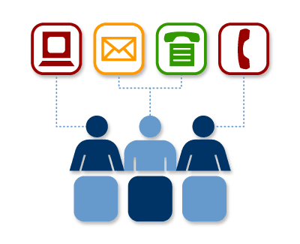
WA BON Licensing Unit
Phone: 360-236-4703
Email for Questions: nursing@doh.wa.gov
Email for Electronic Transcripts: WABONlicensing@doh.wa.gov
Mailing Address (with fees):
Department of Health
PO Box 1099
Olympia, WA 98507
Mailing Address (without fees):
Washington State Board of Nursing
PO Box 47864
Olympia, WA 98504
Notes:
CONTACT SLIDE 1
Quick Help Tips
Contact 1 Box Box:
just add text
Photo Box:
click on the icon in the middle of the box to insert photo
photo will automatically size to fit the square
photo size can also be adjusted
Name/Title/Program Boxes:
just add text
Web Address Box:
add web address or use as is
Social Media Icons:
these images are not editable or linkable
they only denote DOH’s presence in these platforms

Slide 33
Questions?
Notes:
QUESTIONS SLIDE
Quick Help Tips
Questions Box:
just add text or use as is

Slide 34
Notes:
END SLIDE
Quick Help Tips
Insert this slide at the end of the presentation. It is not editable.

